Slide 1

Rockbuster Stealth: What Does the Future Hold?
A Glance at a Promising Future
Mark Regini | April 21, 2022
Notes:
To change the image on this slide, select the picture and delete it. Then click the Pictures icon in the placeholder to insert your own image.

Slide 2
Who Are We?
Rockbuster, LLC, is a long-standing movie rental service with customers around the world and a collection of films as diverse as its clientele. With the industry moving to a streaming format, we must stay ahead of the curve and launch a streaming service of our own.

Slide 3
What’s Our Goal?
The Prime Directive
How do we become more?
Key Questions
What are we doing well?
Who is our main demographic?
How large is our global reach?
Where can we grow from here?
When can our growth start?
Why Do This?
Rockbuster Stealth has become synonymous with quality entertainment, and we must continue this trend in an ever-increasingly competitive market

Slide 4
A Movie Library in Need of Updates
Most Common Rating | PG-13
Most Common Language | English
Our most recent and, in fact, the average movie in our collection is from 2006… 16 years ago!
Rental costs are around industry average, but streaming services should be considered
Most common language is English, which is to be expected

Slide 5
Loyal Customers, but No Growth?
First Customer Start | Last Customer Start | First Information Update | Last Information Update
2/14/2006 | 2/14/2006 | 5/26/2013 14:49 | 5/26/2013 14:49
Store ID | # of Customers
1 | 326
2 | 273
No customer entry since 2006?
Decent customer-to-store ratio, but only two stores in the world!
Very good active customer base
Last customer database update 9 years ago, will need to update and confirm current information
Customer Status | # of Customers
Active | 584
Inactive | 15

Slide 6
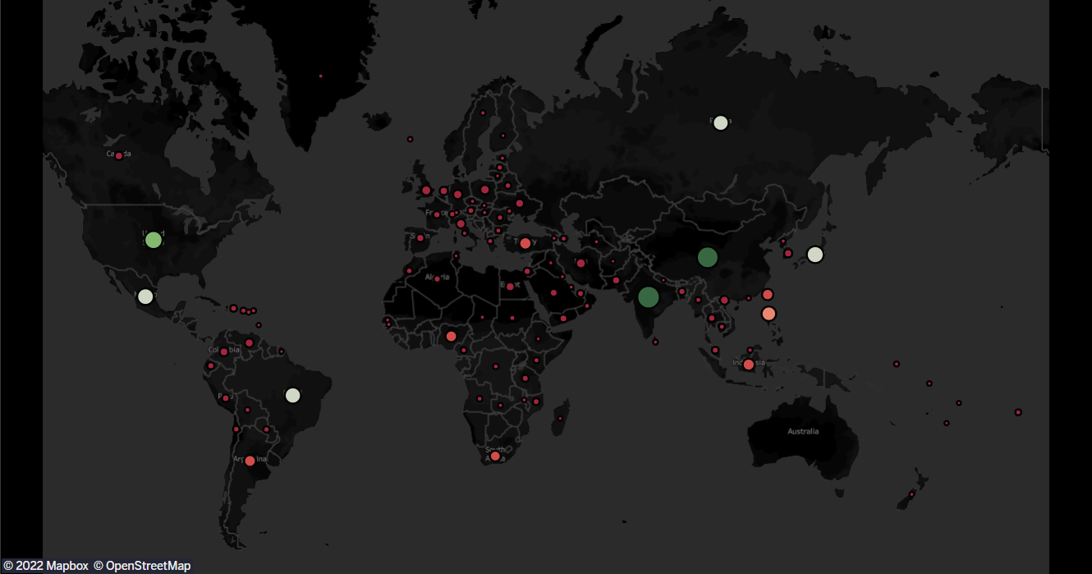
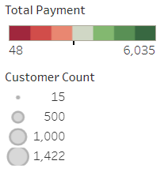
Global Appeal
To access the interactive features of this map, please click here.

Slide 7
Untapped Global Markets
As we can see in the previous map, our customer base is scattered around the world, in 109 countries and 6 continents…
The top 10 countries with our highest customer base didn’t even have a store!
Country | # of Customers
India | 60
China | 53
United States | 36
Japan | 31
Mexico | 30
Brazil | 28
Russian Federation | 28
Philippines | 20
Turkey | 15
Indonesia | 14

Slide 8
Untapped Global Markets (cont.)
If we look at the top cities within our top customer bases, we gain an understanding of the countries who most impact our sales
Our top 5 customers have been the backbone of what we have been able to accomplish, we should recognize their loyalty

Slide 9


Main Takeaways and Recommendations
High retention rate of customers (15 deactivated in 7 years)
Movie collection dominated by English language films
No new customers since 2006, and database not updated since 2013
Marketing opportunity, create top customer incentives and hold release party
Build film library around prominent client bases (Bollywood, Chinese cinema, Telenovela, etc.)
Need to make implementation of database information updates a priority so we can see impact of streaming service, and predict future trends

Slide 10
The End
For follow-up questions, please contact:
Mark Regini
mmregini@gmail.com
(555)289-5564
Notes:
To change the image on this slide, select the picture and delete it. Then click the Pictures icon in the placeholder to insert your own image.

